Slide 1
VOLLEYBALL

Slide 2
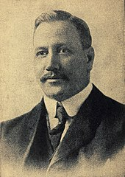
History of Volleyball
1895
William Morgan
Mintonette “ badminton, basketball, handball/ soccer, lawn tennis
Fédération Internationale de Volley Ball (FIVB)
Notes:
In 1895, William G. Morgan, an instructor at the Young Men’s Christian Association. Decided to blend elements of basketball, baseball, tennis, and handball to create a game for his class of businessmen which would demand less physical contact than basketball.
He raise the tennis net 6 feet 6 inches above the average height of man’s head

Slide 3
The court dimensions
A volleyball court is 9 m × 18 m (29.5 ft × 59.1 ft), divided into equal square halves by a net with a width of one meter (39.4 in).The top of the net is 2.43 m (7 ft 11 ¹¹⁄₁₆ in) above the center of the court for men's competition, and 2.24 m (7 ft 4 ³⁄₁₆ in) for women's competition.
The minimum height clearance for indoor volleyball courts is 7 m (23.0 ft), although a clearance of 8 m (26.2 ft) is recommended.

Slide 4
A line 3 m (9.8 ft) from and parallel to the net is considered the "attack line". This "3 meter" (or "10-foot") line divides the court into "back row" and "front row" areas (also back court and front court).These are in turn divided into 3 areas each: these are numbered as follows, starting from area "1", which is the position of the serving player

Slide 5
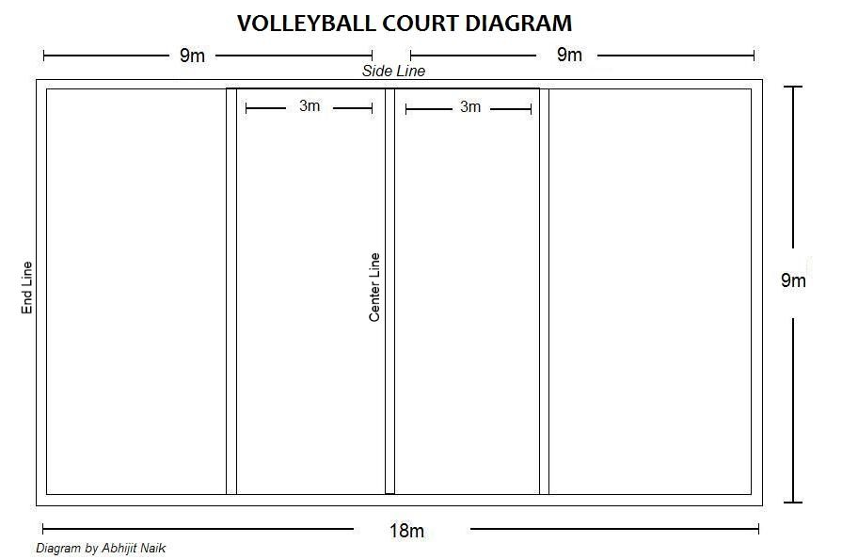

Slide 6
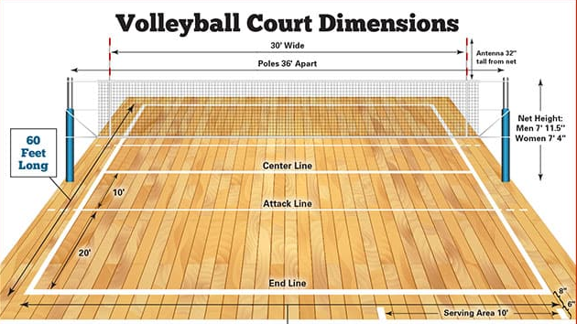

Slide 7
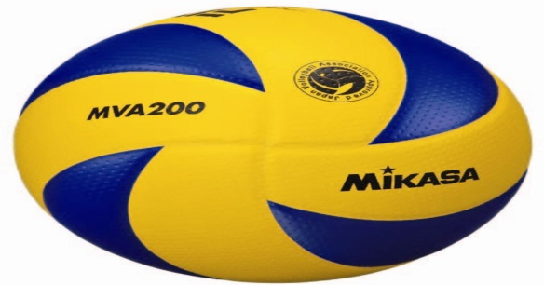
The ball
FIVB regulations state that the ball must be spherical, made of leather or synthetic leather, have a circumference of 65–67 cm, a weight of 260–280 g and an inside pressure of 0.30–0.325 kg/cm².Other governing bodies have similar regulations.

Slide 8
Gameplay
Each team consists of six players. To get play started, a team is chosen to serve by coin toss. A player from the serving team throws the ball into the air and attempts to hit the ball so it passes over the net on a course such that it will land in the opposing team's court (the serve). These contacts usually consist first of the bump or pass so that the ball's trajectory is aimed towards the player designated as the setter; second of the set (usually an over-hand pass using wrists to push finger-tips at the ball) by the setter so that the ball's trajectory is aimed towards a spot where one of the players designated as an attacker can hit it, and third by the attacker who spikes

Slide 9
The game continues in this manner, rallying back and forth until the ball touches the court within the boundaries or until an error is made.
The most frequent errors that are made are either to fail to return the ball over the net within the allowed three touches, or to cause the ball to land outside the court.

Slide 10
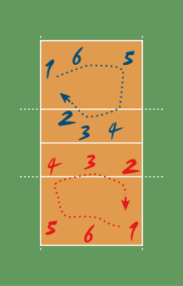

Slide 11
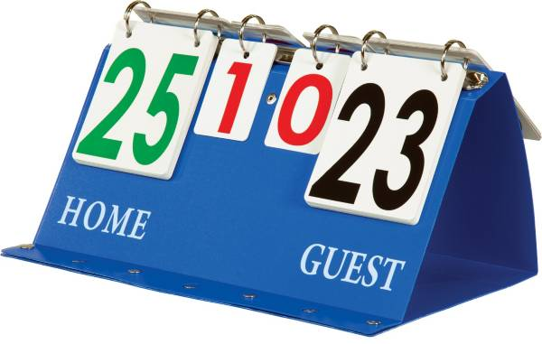
Scoring
A point is scored when the ball contacts the floor within the court boundaries or when an error is made: when the ball strikes one team's side of the court, the other team gains a point; and when an error is made, the team that did not make the error is awarded a point
first team to score 25 points by a two-point margin awarded the set. Matches are best-of-five sets and the fifth set, if necessary, is usually played to 15 points. (Scoring differs between leagues, tournaments, and levels;

Slide 12
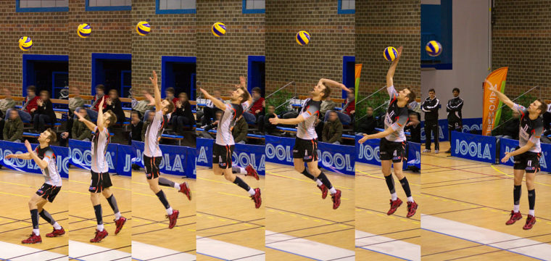

Serve
A player stands behind the inline and serves the ball, in an attempt to drive it into the opponent's court. The main objective is to make it land inside the court; it is also desirable to set the ball's direction, speed and acceleration so that it becomes difficult for the receiver to handle it properly.
KEY HEART R. MARIVELES

Slide 13
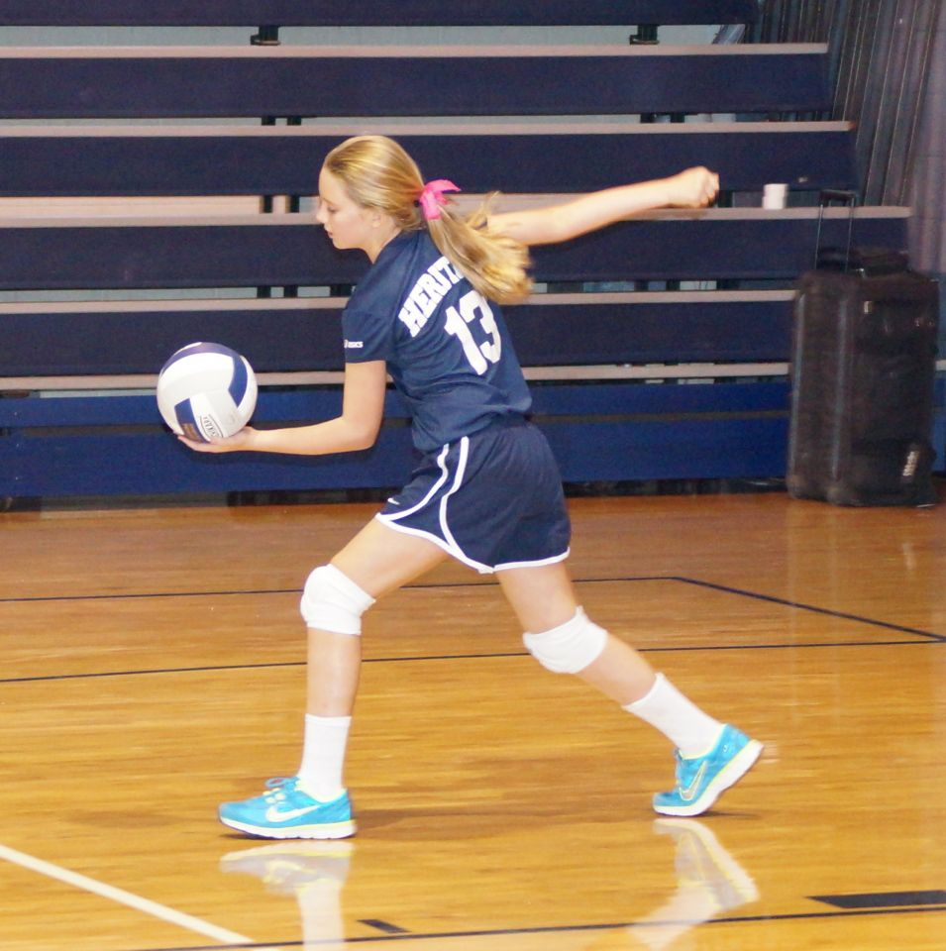
Serve
Underhand Serve - This serve is used mainly in recreational volleyball. It does not require the level of skill or coordination that the other types of serves do. With one foot stepped back, you hold the ball in your opposite hand. Then with your other hand fisted, shift your weight forward and hit the ball just below the center (or equator) of the ball.

Slide 14
Serve
Overhand Serves - In high school and college competitive volleyball, the overhand serves are most common, you start with your dominant-side foot back and the ball held extended in your non-dominant hand. Then you toss the ball up in front of you hitting hand. How you hit it depends on the type of overhand serve you want to create.

Slide 15
Passing
Also called reception, the pass is the attempt by a team to properly handle the opponent's serve or any form of attack. Proper handling includes not only preventing the ball from touching the court but also making it reaches the position where the setter is standing quickly and precisely.

Slide 16
Set
The set is usually the second contact that a team makes with the ball. The main goal of setting is to put the ball in the air in such a way that it can be driven by an attack into the opponent's court. The setter coordinates the offensive movements of a team, and is the player who ultimately decides which player will actually attack the ball.

Slide 17
Blocking
Blocking refers to the actions taken by players standing at the net to stop or alter an opponent's attack.

Slide 18
Volleyball Referee Hand Signals
All one-handed signals are made with the hand toward the side of the team which made the error or request
Immediately after a rally is over, the hand signal “Team to Serve” and a point is always indicated FIRST to the team who earned the next service and point
Next, the hand signal explaining the reason why (or what the game/ball fault is) is indicated

Slide 19
Volleyball Referee Hand Signals

Slide 20
Volleyball Referee Hand Signals

Slide 21
Volleyball Referee Hand Signals

Slide 22
Volleyball Referee Hand Signals

Slide 23
Volleyball Referee Hand Signals

Slide 24
Volleyball Referee Hand Signals

Slide 25
Volleyball Referee Hand Signals

Slide 26
Volleyball Referee Hand Signals

Slide 27
Volleyball Referee Hand Signals

Slide 28
Volleyball Referee Hand Signals

Slide 29
Volleyball Referee Hand Signals

Slide 30
Volleyball Referee Hand Signals

Slide 31
Volleyball Referee Hand Signals

Slide 32
Volleyball Referee Hand Signals

Slide 33
Volleyball Referee Hand Signals

Slide 34
THANK YOU, KEEP SAFE
AND GOD BLESS YOU ALL!!!

